Slide 1
JAVASCRIPT

Slide 2


Slide 3
OVERVIEW

Slide 4
OVERVIEW
About the role of client-side scripting in web development.
How to create fail-safe design that will work even if JavaScript is not enabled.
The important syntactic elements of JavaScript.
About built-in JavaScript objects.
How to validate forms using JavaScript.
About JavaScript pseudo-classes, prototypes, and object-oriented design.
About JavaScript frameworks such as jQuery.
How to post files asynchronously with JavaScript.
How jQuery can be used to animate page elements.
Javascript is single-threaded and synchronous in nature.

Slide 5
BACKGROUND
JavaScript is the preferred language for client-side scripting of web pages.
JavaScript can programmatically access and alter HTML elements and change a web site dynamically.
JavaScript can animate, move, transition, hide, and show parts of a page instead of refresh the entire page.
JavaScript is object-oriented, dynamically/weakly typed(variables easily converted from one to another), lightweight, scripting language.
JavaScript is very different from Java.
JavaScript uses objects that have constructors, properties, and methods.
JavaScript is dynamically instead of statically typed, meaning type checking is done at run-time instead of compile-time.

Slide 6
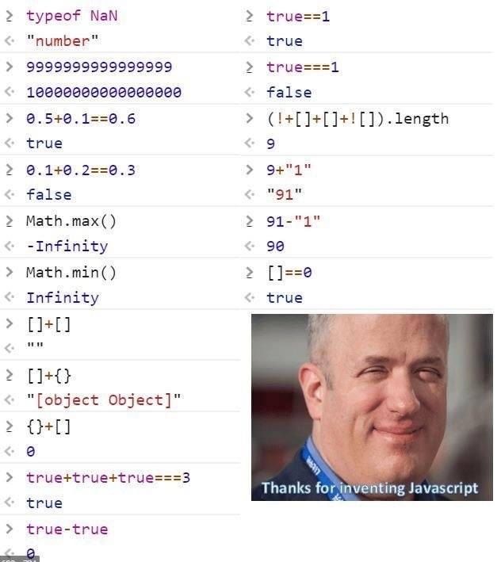
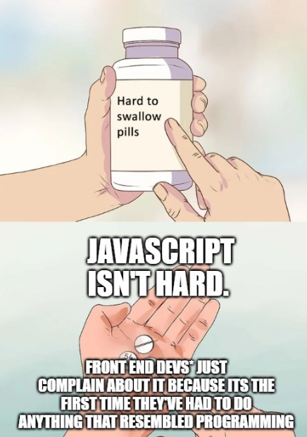

Slide 7


Slide 8
HISTORY
JavaScript was first introduced by Netscape back in 1996.
It was originally called LiveScript but changed to JavaScript because of its support of Java applets.
JavaScript is an implementation of a standardized scripting language called ECMAScript.

Slide 9
CLIENT-SIDE SCRIPTING PROS
Reduces the load from the server computers.
Browser can respond to user events faster.
JavaScript can interact with HTML in ways that servers can’t.

Slide 10
CLIENT-SIDE SCRIPTING CONS
No guarantee that client computer has JavaScript enabled.
Client computers may be unpredictable depending on the operating systems, programs, configs, and browsers used.
Web development can be difficult because of the added interactions of different languages that have to interact properly to display a web page.

Slide 11
LOCATIONS
Similar to CSS, Javascript can be inline, embedded, or external.
It is preferred not to use inline JavaScript because of maintainability and performance reasons.

Slide 12
INLINE
JavaScript can be injected inline on an .html file as shown below.
Similar to CSS, this is bad practice, and done less frequently than CSS.

Slide 13
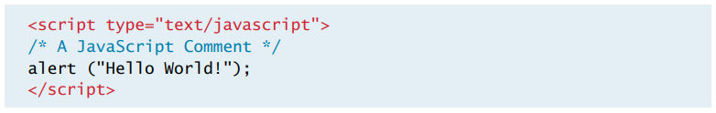
EMBEDDED
Embedded injection is by adding Javascript inside a <script> tag inside the .html file.
The location of this tag is very important, because if some scripts rely on previously declared variables, the page will not run if this tag is placed before those variables are declared.
This<script> tag can be placed inside the <head> or <body> tags.

Slide 14
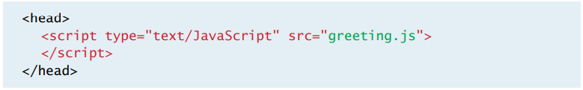
EXTERNAL
External injection is by importing JavaScript through a separate file.
Internal custom Javascript files can be imported as well as libraries hosted on the internet such as JQuery.js, Moment.js, and Toastr.js.

Slide 15
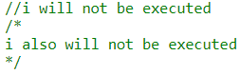
COMMENTS
In-line comments are applied with //.
Multi-line comments are applied with /**/.

Slide 16
VARIABLES

Slide 17
VARIABLES
In JavaScript, variables are dynamically typed, meaning they are called out with a wild card reserved term like ‘var’, ‘let’, or ‘const’ but their value can change from objects, arrays, strings, numbers…etc.
Their values are assigned to the right of their declarations as shown.
No variable should be re-declared after it is declared once.

Slide 18
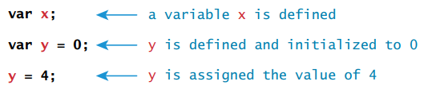
VARIABLES

Slide 19
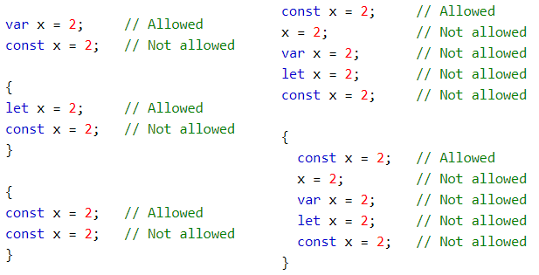
VARIABLES

Slide 20
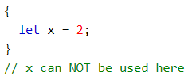
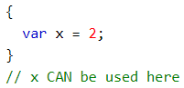
SCOPE

Slide 21
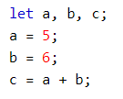
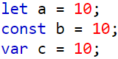
VARIABLES
As of 2015, using ‘let’ to declare variables has replaced ‘var’ because it is better at handling scope i.e. ‘var’ will be accessible anywhere whereas ‘let’ is only accessible within its scope.
The variable declaration ‘const’ is also used but can not be modified downstream and has become the source of many debugging issues.
It is highly recommended to start variable declarations with ‘let’.

Slide 22
VARIABLE GROUPING

Slide 23
VARIABLE SYNTAX
Numbers can be written with or without decimals.
Strings can be written with double dashes or single dashes.
The = sign is used to assign values to variables.
Arithmetic operators like + - * / can used to do math on values.

Slide 24
VARIABLE NOMENCLATURE LIMITATIONS
The first character must be a letter or an underscore (_). You can't use a number as the first character.
The rest of the variable name can include any letter, any number, or the underscore. You can't use any other characters, including spaces, symbols, and punctuation marks.
As with the rest of JavaScript, variable names are case sensitive. That is, a variable named Interest_Rate is treated as an entirely different variable than one named interest_rate.
There's no limit to the length of the variable name.
You can't use one of JavaScript's reserved words as a variable name. All programming languages have a supply of words that are used internally by the language and that can't be used for variable names because doing so would cause confusion (or worse). Note, too, that JavaScript also has many keywords that should be avoided as well.

Slide 25
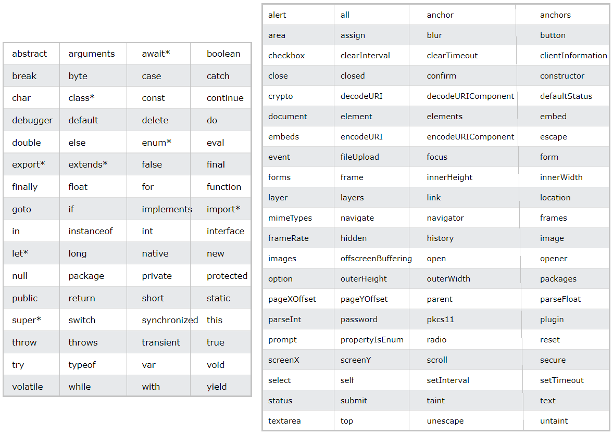
RESERVED WORDS DON’T USE AS VARIABLE NAMES

Slide 26
VARIABLE NOMENCLATURE BEST PRACTICES
Avoid using the variable type on the name. For instance, avoid using ‘gradeString’ or ‘gradeInteger’.
Avoid naming a variable with prepositions like to, from, in, or inside. Instead of using ‘gradeOfStudent’, using ‘studentGrade’.
Keep variables no more or less than 2 words, like studentGrade. Make sure the variable is self-intuitive, meaning a developer can read it and have some idea on what it is.
Using 1 word is too generic and can cause conflict with other variables. Using too many words can be confusing to read.

Slide 27
HOISTING
Hoisting is the process of allowing a programmer to declare variables anywhere in the code and will still work even if they are used before they are called.
The ‘var’ callout can be declared anywhere because of hoisting but the ‘let’ and ‘const’ callout must be declared before used.
Functions are executed in the sequence they are called, not in the sequence they are defined.

Slide 28
NULL + UNDEFINED + NAN
Null means a variable is declared and assigned a value of null but means nothing. Null is also an object but as opposed to standard objects, null objects return falsy.
Undefined means a variable is declared but not defined yet. It’s more common to use undefined than to use null.
NaN represents whether the value is not a number.

Slide 29
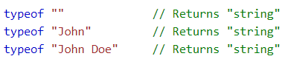
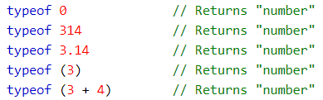
TYPEOF
The ‘typeof’ operator can be used to find the type of a variable.
Typeof doesn’t work on arrays, so use Array.isArray() instead.

Slide 30
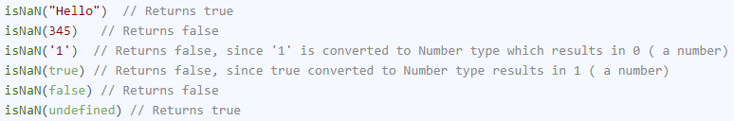
ISNAN
IsNaN can also be used to check if a value is a number.
If !isNaN is true, it’s a number, otherwise it’s not a number. IsNaN converts strings to numbers before checking.

Slide 31
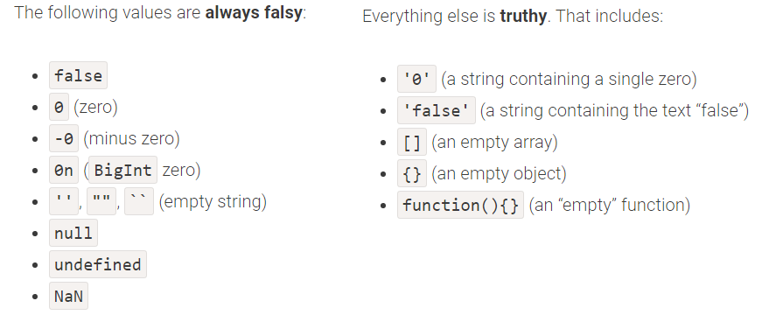
TRUTHY / FALSY
Truthy/Falsy logic is very helpful when doing logic in JavaScript.
Data structures are not always provided with clear cut true and false values and the thruthy/falsy syntax truly helps keep code succinct and readable.
For example, instead of writing if(a != null && a!= undefined) you can just write if(!a) and does the same logic thanks to truthy/falsy logic.

Slide 32
TRUTHY / FALSY
Truthy/Falsy can be checked specifically with the following 2 ways:
Boolean(someVar)
!!someVar

Slide 33
STRINGS

Slide 34
STRINGS
The string class is used to defined arrays of chars.
JavaScript has a series of reserved string methods are included on each string declaration such as charAt(), indexOf(), split(), search(), and match().

Slide 35
STRINGS
There are 3 different ways that strings can be concatenated.
Using the `` tick notation came out in 2015 per the ES6 notation and is often used in development because it eases the process of concatenating strings with variables.

Slide 36
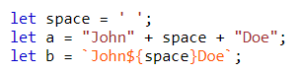
STRING CONCATENATION

Slide 37
STRING METHODS
Length()
Slice()
Substring()
Substr()
Replace()
ToUpperCase()
ToLowerCase()
Concat()
Trim()
PadStart()
PadEnd()
CharAt()
CharCodeAt()
Split(‘,’)

Slide 38
NUMBERS

Slide 39
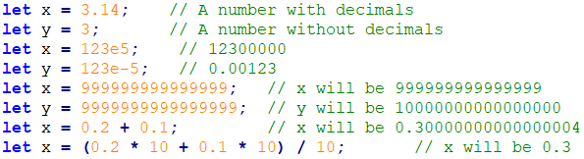
NUMBERS

Slide 40
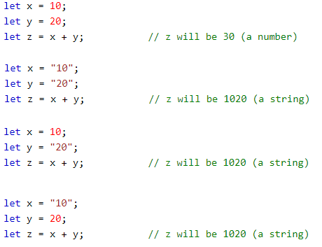
NUMBERS

Slide 41
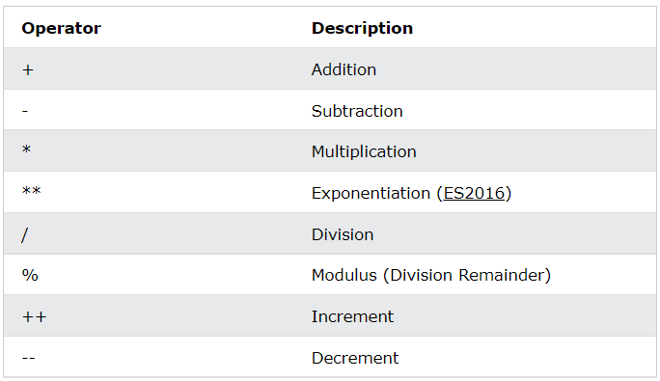
ARITHMETIC

Slide 42
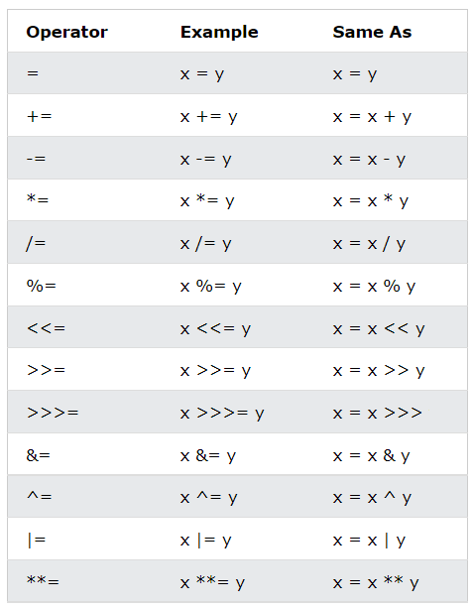
ASSIGNMENT

Slide 43
OBJECTS

Slide 44
OBJECT ORIENTED PROGRAMMING
Javascript is not a fully OOP program because it doesn’t use inheritance and polymorphism to the extent of other OOP programs like Java and C++.
However, it does use the object structure extensively, using constructors, properties, and methods.

Slide 45
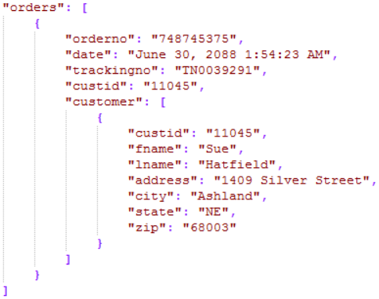
JSON
JavaScript Object Notation(JSON) is the most common way to define JavaScript structures.
It can include a variety of data entries such as arrays, objects, strings, integers,…etc.
Object keys are not limited to variable notation, they are similar to strings, they can include spaces, start with numbers,…etc.

Slide 46
INITS
Every data structure in JavaScript(whether array, boolean, date, math, string, object,…etc.) requires a constructor to initialize them.
These initializations can be defined in different ways.

Slide 47
PROPERTIES
Properties are defined with dot notation that separates the instance with the property.

Slide 48
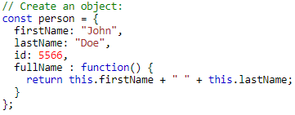
METHODS
Objects can also have methods assigned to them.
These functions will run whenever they are called using the same dot notation used to call properties.
Calling these functions may return different results depending if its object fields were changed.

Slide 49
DOCUMENT OBJECT MODEL(DOM)
It’s very common for JavaScript to have to interact with the HTML of a page using the DOM i.e. indicators need to change, colors need to change, events need to be handled…etc.
According to the W3C, the DOM is a platform and language neutral interface that allows programs and scripts to dynamically access and update the content, structure, and style of documents.

Slide 50
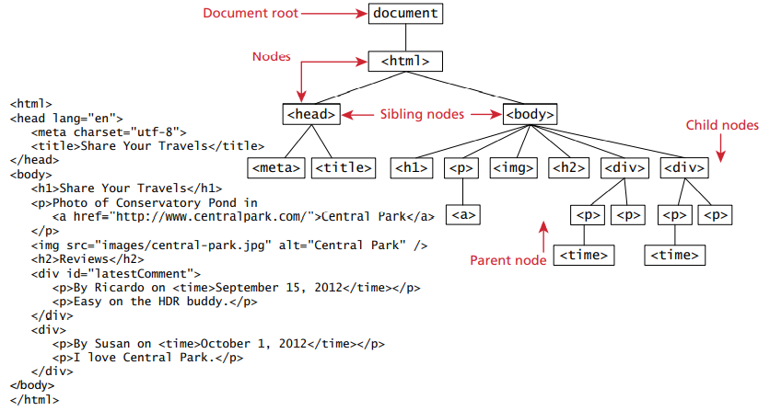
DOCUMENT OBJECT MODEL(DOM)

Slide 51
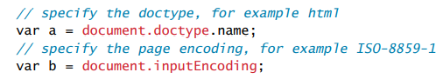
DOCUMENT OBJECT
The document object is the root JavaScript object representing the entire HTML document.
It includes some information about the page including docType and inputEncoding.

Slide 52
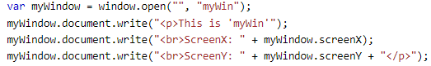
BROWSER OBJECT MODEL(BOM)
The BOM is similar to the DOM, but includes a bunch of objects that are accessible within a browser.
This includes history, screen, navigator, and location objects.

Slide 53
ARRAYS

Slide 54
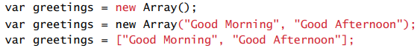
ARRAYS
Arrays are very popular in JavaScript.
Arrays can be defined using the different syntax below.
It’s important to stay consistent with notations throughout an app.

Slide 55
ARRAYS
Array values can be accessed using the [] notation and inserting an index.
An error will occur if the index is out of bounds.

Slide 56
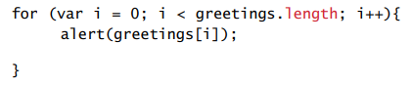
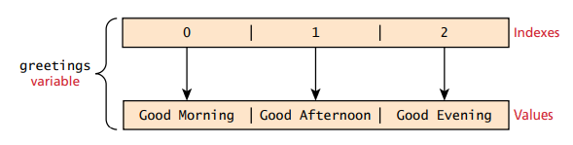
ARRAYS
Loops are often used to traverse through arrays and access each item.
This can be done using a standard ‘for’ loop or ‘for each’ loop.

Slide 57
ARRAYS
Adding an item to an array can be done using the .push() notation.
To remove an item, the .pop() notation can be used.
Additional array methods include concat(), slice(), join(), reverse(), shift(), and sort().

Slide 58
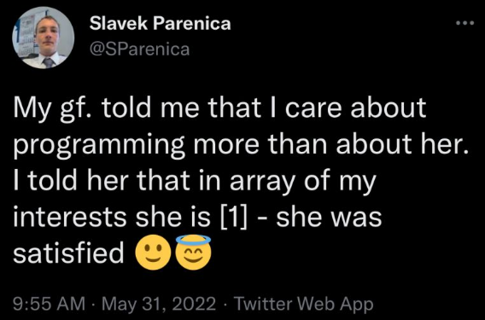

Slide 59
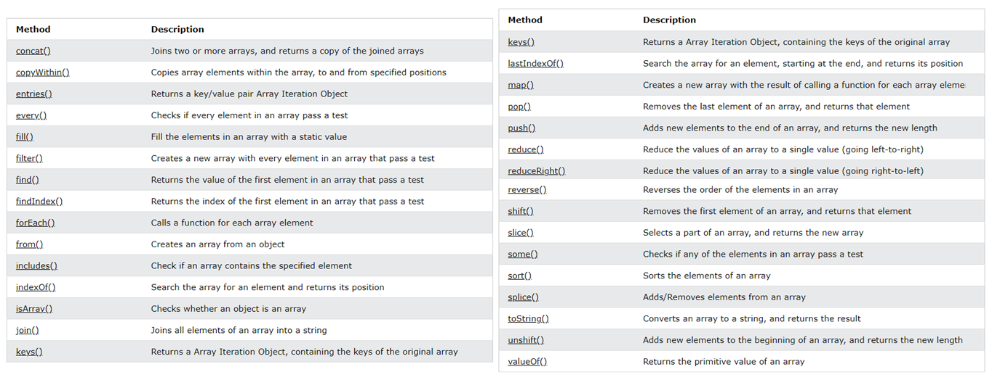
ARRAY METHODS
A forEach() function does not return anything.

Slide 60
COPYING ARRAYS
Arrays in JavaScript are not deep copied by default, they are shallow copied.
Shallow copies mean that only pointer references are copied, not the structure themselves.
For instance, if array A is assigned array B, and A[0] = 5 is assigned after the copy, then B[0] will automatically be set to 5 also.
To prevent this, a deep copy is required, and one of the common ways of achieving this is by using JSON.parse and JSON.stringify functions. This method works for most structures, but it does glitch out on unique fields and data types.

Slide 61
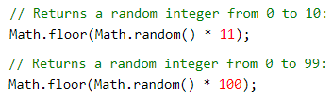
RANDOM

Slide 62
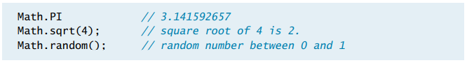
MATH
The math class is used to access common mathematic functions and values quickly.
JavaScript math functions include max(), min(), pow(), sqrt(), exp(), sin(), cos(), and arctan().
It also includes PI, E, and SQRT2.

Slide 63
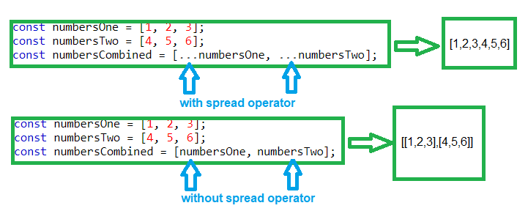
THE … SPREAD OPERATOR
The spread operator is used to flatten an array.
They are useful when concatenating arrays. If you don’t use a spread operator, and push an array as is, you will push an array inside an array instead of its elements.

Slide 64
DATES

Slide 65
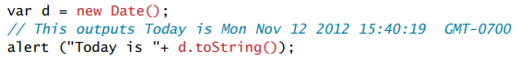
DATES
The JavaScript date class is also very helpful for declaring dates and times.
The date functions of JavaScript can sometimes have limitations. For this reason, the moment.js library is often imported to address this issue.

Slide 66
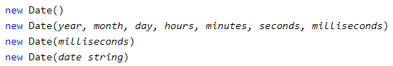
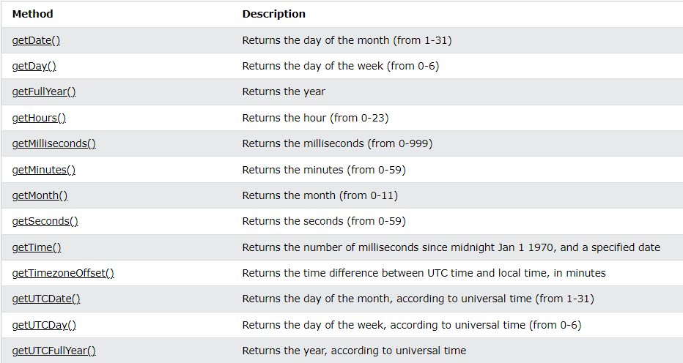
DATES

Slide 67
CONDITIONALS

Slide 68
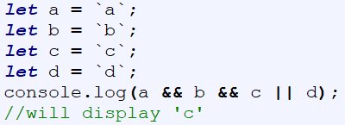
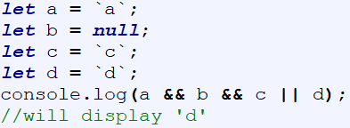
CONDITIONAL ASSIGNMENTS
Variables can also be assigned using the && and || operators but they are used differently to if-else statements.
If an && symbol is used, it means that if the operand on the left is thruthy, the operand on the right will display.
If an || symbol is used, it means that if the operand on the left is falsy, the operand on the right will display.

Slide 69
OPTIONAL CHAINING
Conditional assignments are used in the form of optional chaining to avoid throwing an error if a nested field doesn’t exist.
Traditionally, optional chaining was achieved with this syntax:
let someVar = a && a.b && a.b.c;
But as of 2020, optional chaining was introduced with this syntax:
let someVar = a?.b?.c;

Slide 70
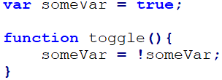
TOGGLE SYNTAX
Toggling variables is often done with the ! operator.
Toggling can be used for checkbox bindings, collapsing elements, or hiding elements.

Slide 71
== VS ===
Triple equals checks for value AND format (example 2 === ‘2’ returns false).
Double equals checks for value only (example 2 == 2 returns true).
It’s best to use triple equals.

Slide 72
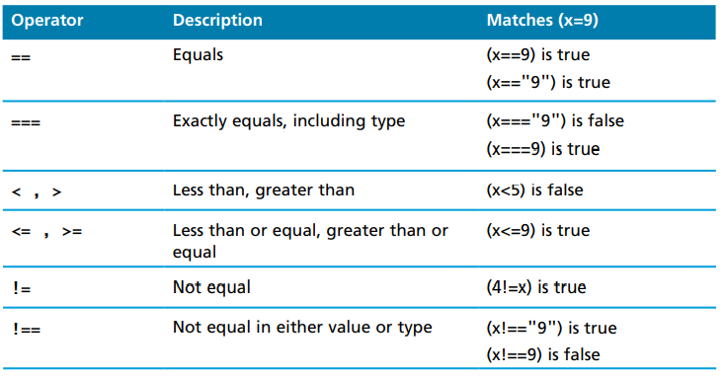
COMPARISON OPERATORS

Slide 73
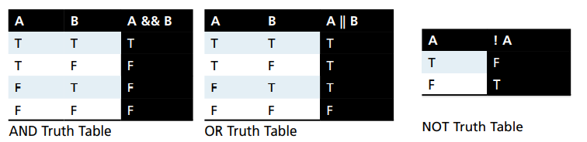
CONDITIONALS
JavaScript uses the standard AND, OR, and NOT conditionals just like in any other language.

Slide 74
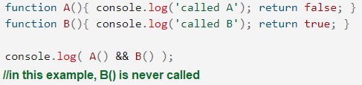
SHORT CIRCUIT
JavaScript short circuits are used to avoid evaluating every statement in an if statement.
This is advantageous not only for performance reasons but also because proceeding statements could glitch out if evaluated.
A short circuit evaluation uses the double && or II operators whereas an evaluation without short circuit uses the single & or I operators.
A single & or I will evaluate all statements regardless if the initial one is true or false.

Slide 75
CONDITIONAL TYPES

Slide 76
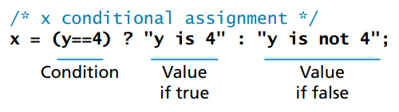
TERNARIES
JavaScript variables can also be assigned using ternary conditionals as shown below.
In the example below, if Y equals 4, it will display ‘y is 4’, otherwise, it will display ‘y is not 4’.

Slide 77
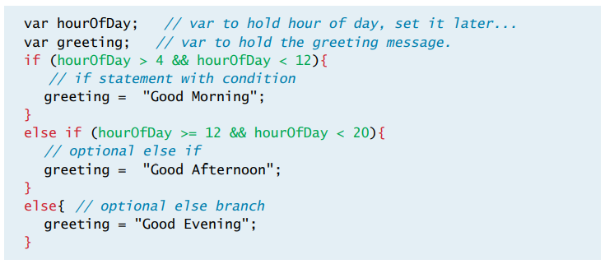
IF-ELSE STATEMENTS

Slide 78
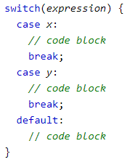
SWITCH STATEMENT

Slide 79
LOOPS

Slide 80
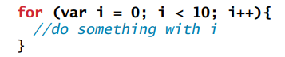
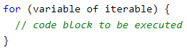
FOR LOOPS
A ‘for’ loop combines the common components of a loop, with initialization, condition, and post-loop operation into one statement.
If break is used inside the ‘for’ loop, it will exit out of the loop.
If continue is used inside a ‘for’ loop, it will skip the iteration.
If return is used inside a ‘forEach’ loop, it will skip the iteration.
THERE IS NO WAY TO BREAK OUT OF A .FOREACH LOOP

Slide 81
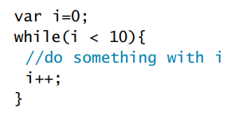
WHILE LOOPS
A while loop ends when a condition is met, otherwise it continues to loop.
While loops can be dangerous, because as opposed to ‘for’ loops, they are more likely to continue endlessly in an infinite loop if not coded properly, and crash the browser.
Luckily, most browsers nowadays have a kill operation when it realizes that it is stuck in an infinite loop.

Slide 82
FUNCTIONS

Slide 83
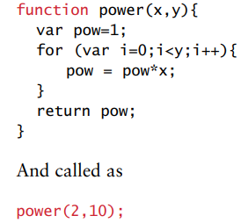
FUNCTIONS
Functions are the building blocks for modularity in JavaScript.
They are defined by using the reserved word ‘function’ before the function name and optional parameters.
Since JavaScript is dynamically typed, functions do not always need to return a type.
JavaScript functions support overloads without having to define separate functions. For example, power(1) or power(1,2) will call the same function.

Slide 84

CALLBACK FUNCTIONS
A function passed as an argument to another function.
They are often used on asynchronous communications, where one function has to wait for another function.

Slide 85

ARROW NOTATION
Arrow notation is often used with array methods because it is more succinct.
The values inside the () are the params and the values inside the {} is the logic. A return line is required if {} is used. If {} is not used, a return line is not required but the logic is usually only written within one line.

Slide 86

GENERATORS
Generators are functions that can return multiple values in a sequence.
It does this using function* syntax, the .next() method, and will return a value, done object.

Slide 87

CLOSURES
Closures are an ability of a function to have access to variables outside their declared scope.

Slide 88

EVALS
The eval() function turns a string into an expression.

Slide 89

REGEX
Regular expressions(regex) is a series of characters that translate into a series of functions.
They are often used for input validation i.e. scanning for proper email, phone, or number formats.
Although they are confusing to read, they are a very succinct way to code. A single line regex could equate to a 100 line if-else statement.

Slide 90

REGEX TESTING

Slide 91


REGEX MODIFIERS

Slide 92


ALERTS AND CONFIRMS
The alert() and confirm() functions are used to display pop-ups to the user.
Alerts are usually never used on production code, most serious applications use custom professional modals, but alerts are good for debugging.

Slide 93
DOM

Slide 94

NODES
In the DOM, each element within an HTML document is a node.
The most common task in JavaScript is finding the right node, accessing it, and modifying it using properties and methods.

Slide 95

NODES

Slide 96

DOM ACCESS
One of the common ways to select elements in HTML is using the getElementById() method.
This method selects a specific Id on the HTML, and binds JavaScript to it. There is also a class version of this with getElementByClassName().
Jquery.js is known for being the most popular JavaScript library for DOM manipulation.

Slide 97

DOM ACCESS

Slide 98
ELEMENT NODE OBJECT
The object returned from .getElementById() is an element node object.
The node object includes the content wrapped around the <> and </> tags.

Slide 99

ELEMENT NODE OBJECT
The node object contains several properties that can be accessed.

Slide 100

ELEMENT NODE OBJECT
Some of these properties are only accessible based on the element selected.

Slide 101

ELEMENT NODE OBJECT

Slide 102


DOM CONTENT MODS
Using the element node object, changes can be made to content in the DOM.

Slide 103

DOM NODE MODS
Using the element node object, changes can also be made by adding and removing nodes from the DOM.

Slide 104

DOM STYLE MODS
Using the element node object, changes can also be made to the style of the DOM.
It is encouraged to use a class selector when changing an HTML element style dynamically using JavaScript.

Slide 105
EVENTS

Slide 106
EVENTS
An event is an action that can be detected by JavaScript and serve as a trigger.
Most of created by inputs from the user, but others can be triggered by the browser.
An event is said to be triggered, and then caught by a JavaScript function, and the response is executed.
Event handlers are used to respond to certain events.

Slide 107

HOOKS
JavaScript can be inserted inline, embedded, or on an external file.
In the 90s, events were historically inserted inline a tag using hooks, but later they were inserted using listeners.

Slide 108
LISTENERS
The idea of listeners is that the HTML is left intact, but JavaScript selects certain elements and adds an event to it.
This method is better than using old fashion event hooks because it uncouples the HTML from the JavaScript.
The disadvantage is that only one handler can respond to any given element event.

Slide 109


LISTENERS
Another way to add listeners is by using functions.

Slide 110

EVENT BUBBLING
When an event happens on an element, it first runs the handlers on it, then on its parent, then all the way up on other ancestors.
For instance, in the blue boxes shown, if all 3 elements(form, div, p) have an event, and p is clicked, the p event will handle first, the div event will handle second, and the form event will handle third.
To prevent bubbling the event.stopPropagation() can be used to only run the event clicked on.

Slide 111

EVENT BUBBLING

Slide 112

EVENT OBJECT
Event functions pass a parameter called the event object, that provides information about the DOM element.
This object has a lot of useful properties and methods such as bubbles, cancelable, and prevent default.

Slide 113
EVENT OBJECT
Bubbles is a bool is set to true, so it knows to first check for an event handler at the element, otherwise it will continue to bubble up to the parent searching for this handler, all the way up to the root. If none is found, the event will remain unhandled.
Cancelable is a bool that indicates whether the event can be cancelled.
PreventDefault actually cancels a default event. So if an event is cancellable, the preventDefault function will often follow. An example is preventing a link from opening up and bypassed with other code.

Slide 114

MOUSE EVENTS

Slide 115

KEYBOARD EVENTS

Slide 116


Slide 117

KEYBOARD EVENT EXAMPLE
Keyboard events can often be used for filters, that need to re-filter on key-up or key-press events.

Slide 118

FORM EVENTS

Slide 119

FORM EVENT EXAMPLE

Slide 120

FRAME EVENTS
Frame events usually run based on the life cycle of the page and run once.
They can trigger if user loads page or exits page.

Slide 121

FRAME EVENT EXAMPLE

Slide 122

EVENT COMPATIBILITY
Some browsers interpret keyboard events differently and multiple conditions sometimes have to be defined.

Slide 123
CLASSES

Slide 124

CLASS CONSTRUCTORS
A JavaScript class is used to define a set of fields and methods that can be recycled to multiple instances.
To create a class, a constructor is required followed by instances, that are defined with the ‘new’ reserved word.

Slide 125

CLASS PROTOTYPES
Once a constructor is created, it can not be modified unless a prototype is used.
A prototype can add or delete properties and methods from a constructor as shown below.

Slide 126

‘THIS’ NOTATION
The ‘this’ notation is often used in JavaScript and refers to the object it belongs to.
If it is used outside an object of a vanilla.js file, it pulls the window object.
In classes often used by frameworks, it references the global variables and functions of the class.

Slide 127
SEQUENCING

Slide 128

PROMISES
A promise represents an operation that hasn’t completed yet.
It is an object that represents the eventual completion or failure of an asynchronous operation.
In the syntax below, the returned object from getData() will be accessible inside the scope of the provided { } once the request is complete, it will not be accessible outside.
Promises can be chained with .then()
The returned states is either resolved, rejected, or pending.

Slide 129

ASYNC / AWAIT
The Async/Await syntax is an alternative way to make promises easier to code so that they are sequential.
The Async syntax is used before the function definition, and await is used before the function call.
They are easier to see process flow as opposed to promises.

Slide 130

TIMEOUTS
Timeouts are used to run code after a set duration.
They are often used for sequencing in full-stack development.
One example usage of a timeout could be to focus on a textbox after certain features of the DOM is loaded.

Slide 131
OTHER

Slide 132

SERIALIZE
The JavaScript serialize() function is used to generate a param url of provided values.

Slide 133

STRINGIFY
The stringify() function is used to convert a JSON into a string.
This can be used to store a JSON into a database that doesn’t inherently take JSON but takes a string like SQL.

Slide 134

JAVASCRIPT ETIQUETTE
Use lower camelCase on variable names.
Indent and group code properly like an outline.
Add spaces around operators.
Add a comment above every scope of code.
Avoid line lengths longer than 80 chars for readability reasons.
Place the brackets using K&R notation instead of Allman notation.

Slide 135
FLASH
Flash is a vector based drawing and animation program.
Flash uses it’s own JavaScript language called ActionScript.
Flash is often used for animated advertisements and online games.
Flash objects are in an SWF format and are included within an HTML document via the <object> tag. This SWF is downloaded by the browser and displayed.
Browsers no longer support Flash as of Dec 2020 because of annoying updates and security issues.

Slide 136

FLASH

Slide 137
AJAX
Asynchronous JavaScript with XML (AJAX) is a system used to send message back to the server without interrupting the state of the current browser.
AJAX is a style of website development that makes use of JavaScript to be responsive and asynchronous.
These asynchronous requests are done using the XMLHttpRequest object.
AJAX responses are captures as events in JavaScript.
AJAX delivers better website continuity by keeping server calls asynchronous.

Slide 138

AJAX

Slide 139

SYNCHRONOUS

Slide 140

ASYNCHRONOUS

Slide 141

AJAX

Slide 142


STANDARD HTTP VS AJAX

Slide 143

LAYERS
JavaScript can be described in a presentation, validation, and asynchronous layers.
The presentation layer is where JavaScript alters the frontend HTML that is visible to the user.
The validation layer is where JavaScript makes sure a form has proper inputs from the user.
The asynchronous layer is where requests are made to the server for

Slide 144
EXERCISES

Slide 145
STRING METHODS/DATES
Given:
let a1 = ‘first’;
let a2 = ‘last’;
lat a3 = ‘id’;
Let a4 = ‘ A A A A ’
Exercises:
Capitalize all the letters of a1 so the output is: FIRST
Capitalize the 1st letter of a1 so the output is: First
Concatenate a1, a2, and a3 so the output is: first, last (id)
On that last output string, replace ‘first’ with ‘john’ and ‘last’ with ‘smith’ so the output is: john, smith (id)
On that last output string, use a string method to return smith so the output is: smith
Remove the trailing and leading white space from a4 and replace all As with Bs so the output is: B B B B
Create a string that displays the current date in this format: 10/02/22

Slide 146
DATA MANIPULATION
Given:
let someJson = [{_id: 1, a: 15}, {_id: 11, a: 21}, {_id: 4, a: 8}, {_id: 7, a: 42}, {_id: 95, a: 9}];
Exercises:
Return an array with only the ‘_id’ field: [‘a’, ‘b’]
Return an array with objects that have an ‘a’ field larger than 10 and sort by ‘_id’:
[{_id: 1, a: 15}, {_id: 11, a: 21}, {_id: 7, a: 42}]
Return an array with a single field b that adds the fields ‘_id’ and ‘a’:
[{b: 16}, {b:32}, {b:12}, {b:49}, {b:104}, {b:5}]
Return a single number that is the sum of the ‘a’ field: 95
Return true if array has an item with an ‘_id’ larger than 45: true
Return true if array has every item with an ‘_id’ larger than 45: false

Slide 147
ARRAY ALGORITHMS
Determine if a string is a palindrome(reads same forward and backwards):
palindrome(‘racecar’) //true
palindrome(‘vehicle’) //false
Get the max value of an array
getMaxValue([10,99,1,151,75,8]) //151
Return the most common token from a provided array:
getCommonToken([1,1,2,3,1,2]) //1
Remove all strings from a provided array
removeStrings([51,25,”AB”,90,”C”]) //[51,25,90]

